Slide 1
Software Testing and Quality Assurance
Lecture – 14

Slide 2
Agenda
Use-case based Testing
Extracting scenarios from Use cases

Slide 3
USE CASES (DIAGRAMS/DESCRIPTIONS)
FOR TESTING

Slide 4
Use-Cases for Testing
Use cases is a wide used technique to define functional requirements.
The test phase must assure that the final software system covers these functional requirements.
There are two very used techniques for extracting test cases from use cases:
Scenario analysis, based on scenario identification.
Test data analysis, based on category partition method

Slide 5
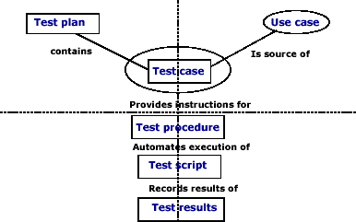
Use case and test artifacts

Slide 6
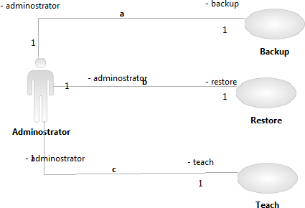
Use Case Diagram

Slide 7
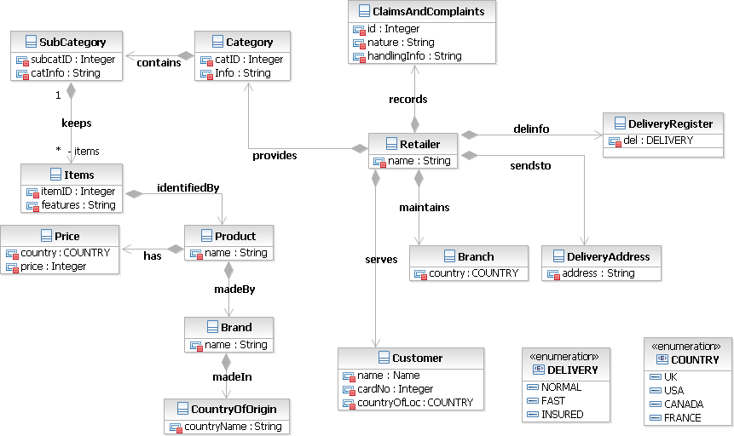
Class Diagram

Slide 8
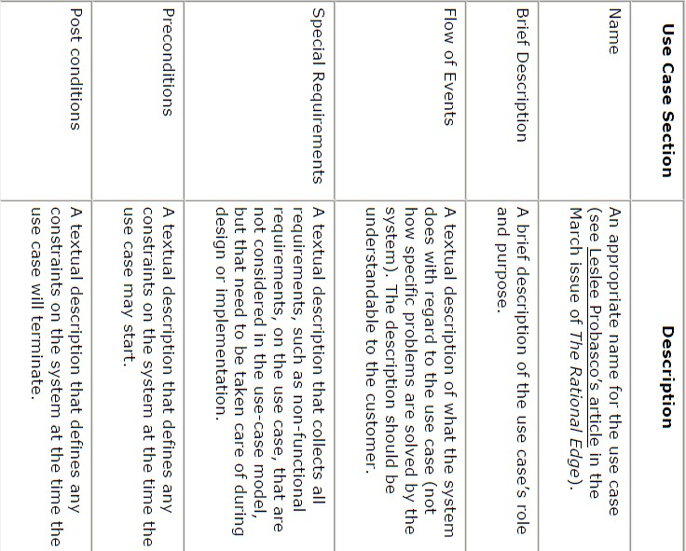
Use Case Description

Slide 9
Use-Case Scenarios
In case of a business scenario
A business scenario is written considering user view of the system
It reflects a business interaction or a business process
In case of extracting scenarios from use-case diagrams
A scenario is an instance of a use case
Execution view of a specific user
How a user would execute it in a specific way.

Slide 10
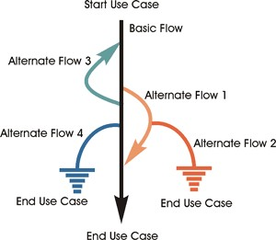

Slide 11
Deriving Test-Cases from Use-Cases
A Four Step Process:
Identify the use case scenarios.
For each scenario, identify one or more test cases.
For each test case, identify the conditions that will cause it to execute.
Complete the test case by adding data values
WsKLab
2016-11-23 10:42:11
--------------------------------------------
http://www.guru99.com/traceability-matrix.html

Slide 12
Step-1 Identify the use case scenarios
WsKLab
2016-11-23 10:42:11
--------------------------------------------
http://www.guru99.com/traceability-matrix.html
Use simple matrix that can be implemented in a spreadsheet, database or test management tool.
Number the scenarios and define the combinations of basic and alternative flows that leads to them.
Many scenarios are possible for one use case.
Not all scenarios may be documented. Use an iterative process.
Not all documented scenarios may be tested.
Use cases may be at a level that is insufficient for testing.
Team’s review process may discover additional scenarios.

Slide 13
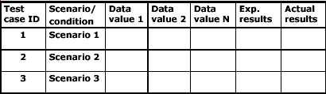
Step 2- Identify the test cases
Parameters of a test case:
Conditions
Input (data values) - How????
Expected result
Actual result

Slide 14
Step 3-Identify the test conditions
For each test case identify the conditions that will cause it to execute a specific events.
1. Use matrix with columns for the conditions and for
each condition state whether it is
Valid (V): Must be true for the basic flow to execute.
Invalid (I): This will invoke an alternative flow
Not applicable (N/A): To the test case

Slide 15
Step 4 – Add data values
Design real input data values that will make such conditions to be valid or invalid and hence the scenarios to happen.
Options
look at the use case constructs and branches.
Consider category-partitioning
Boundary value analysis

Slide 16
Coverage Analysis
Model-based coverage i.e.,
All MCAs covered
All ACAs covered
Question
How can we relate or equate this to actual code coverage
Do we need to make any assumptions?

Slide 17
Example use case model: microwave oven
Initiator
Cook Food
Cook
Microwave Oven System
Timer
Reference: Gomaa, H., Designing Software Product Lines with UML
: From Use Cases to Pattern-Based Software Architectures, Addison- Wesley, Reading 2004.

Slide 18
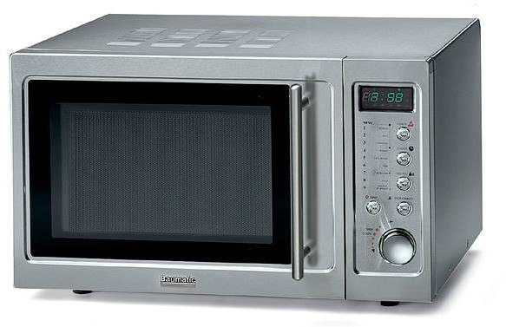
Use Case Name: Cook Food
Brief description: This use case describes the user interaction and operation of a microwave oven. Cook invokes this use case in order to cook food in the microwave.
Added value: Food is cooked. Scope: A microwave oven Primary actor: Cook Supporting actors: Timer Preconditions:
The microwave oven is waiting to be used.

Slide 19
Main Success Scenario
Cook opens the microwave oven door, puts food into the oven, and then closes the door.
Cook specifies a cooking time.
System displays entered cooking time to Cook.
Cook starts the system.
System cooks the food, and continuously displays the
remaining cooking time.
Timer indicates that the specified cooking time has been reached, and notifies the system.
System stops cooking and displays a visual and audio signal to indicate that cooking is completed.
Cook opens the door, removes food, then closes the door.
System resets the display.

Slide 20
Alternate Flows
1a. If Cook does not close the door before starting the system (step 4), the system will not start.
4a. If Cook starts the system without placing food inside the
system, the system will not start.
4b. If Cook enters a cooking time equal to zero, the system will not start.
5a. If Cook opens the door during cooking, the system will stop cooking. Cook can either close the door and restart the system (continue at step 5), or Cook can cancel cooking.
5b. Cook cancels cooking. The system stops cooking. Cook may start the system and resume at step 5. Alternatively, Cook may reset the microwave to its initial state (cancel timer and clear displays).

Slide 21
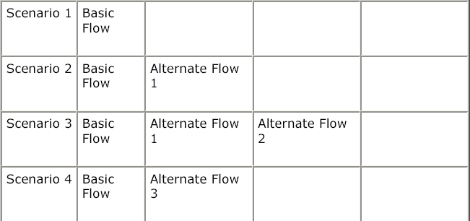
Scenarios for Use-Case
…

Slide 22
Generating Test-Case
For Each use case, generate a full set of use-case scenarios.
For each scenario, identify at least one test case and the conditions that will make it "execute.“
For each test case, identify the data values with which to test.

Slide 23
Step One: Generate Scenarios
Read the use-case textual description and identify each combination of main and alternate flows -- the scenarios -- and create a scenario matrix.
Use case ID | Scenario ID | Scenario Description | Starting flow | Target Flow
1 | 1-1 | Scenario 1 – Successful Cooking | MCA | MCA
1 | 1-2 | Scenario 2 – Door Open | MCA | ACA1
1 | 1-3 | Scenario 3 – No Food | MCA | ACA2
1 | 1-4 | Scenario 4 – Door Open during cooking | MCA | ACA3
… | … | Scenario 5 – Cooking cancelled | MCA | ACA4

Slide 24
Step two: Identify Test Cases
We do this by:
Analyzing scenarios
Reviewing use case textual representation
Step 2: Identify test cases
There should be at least one test case per scenario
E.g., test case for door open scenario identified previously
We develop a test suite containing information e.g.,
Test case id
Scenario/condition reference
Inputs
Preconditions
Expected output
Post-conditions
Pass/fail criteria

Slide 25
Step Three: Identify data
We need to identify suitable data to execute the identified test cases
T C ID | Scenario ID | Input 1 | Input 2 | Input 3 | Expected Output | Post- Condition | Pass/Fail Criteria
T1 | 1-1 | Food | Timer | Start | Explosion, | Food | Explosion,
 |  | placed | initialized | cooking | My God…, | wasted | Food on
 |  | for | to 1 min | button | didn’t I tell | and oven | floor
 |  | cooking |  | pressed | you not to | blown in
 |  |  |  |  | do this | air…
 |  |  |  |  | (wife
 |  |  |  |  | shouting…),
 |  |  |  |  | husband
 |  |  |  |  | giving lame
 |  |  |  |  | excuses as
 |  |  |  |  | usual…
… | … | … | … | … | … | …

Slide 26
Results
What if
We identify additional scenarios e.g.,
Power failure and restoration during cooking
Cooking started with too much load
Cooking with metal plate in the food
We find
scenarios implemented but not defined
scenarios defined but not implemented
We report anomalies on the basis of
Mismatches between specification and implementation

